Slide 1

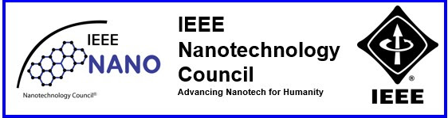

Nanotechnology Student Chapter University Politehnica of Bucharest, Romania
1st Summit of IEEE EPS&NTC Student Branch Chapters
12th September 2022, Sibiu, Romania

Slide 2




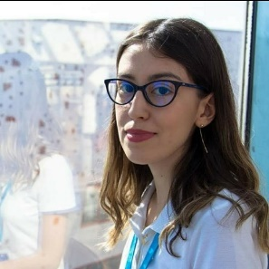
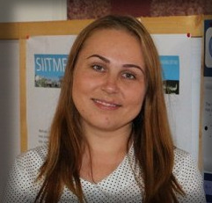
New SBC Executive Committee and Advisor
Mădălina-Irina BURCEA (IONECI)
Chair
Daniela-Mihaela PAVEL
Vice-Chair
Cristina-Mihaela LEPĂDATU
Secretary
Andreea
CHIOREANU
Treasurer
Ana-Maria NICULESCU
Webmaster
Rodica-Cristina NEGROIU
Advisor

Slide 3
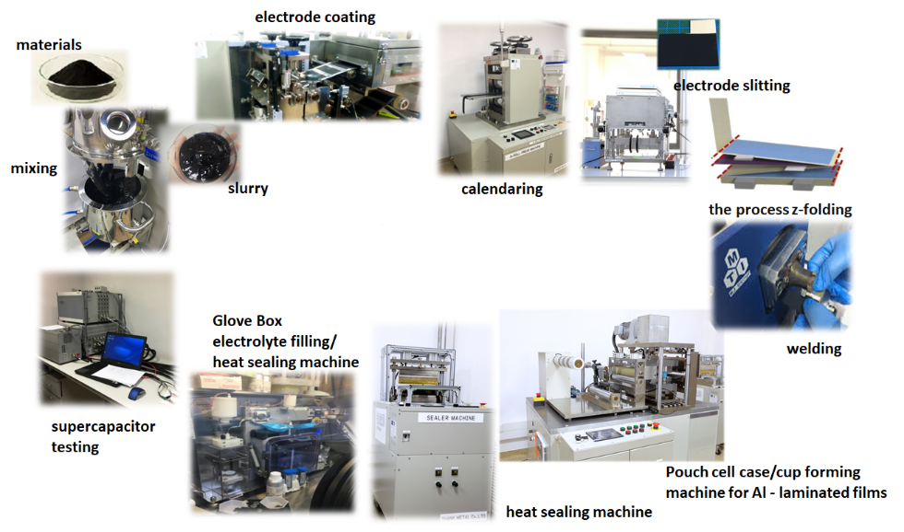
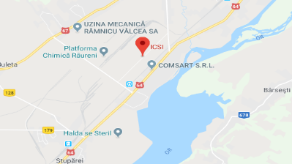
Our projects Realization of Pouch cell Supercapacitor
The purpose of our first project was to develop a supercapacitor, a pouch type cell using an ionic liquid as an electrolyte to increase the value of the working voltage and for electrode we used a nanomaterial, carbon black (95%). This project was implemented at National Research and Development Institute for Cryogenic and Isotopic Technologies – ICSI, Râmnicu Vâlcea.
The National Research and Development Institute for Cryogenic and Isotopic Technologies – ICSI, Râmnicu Vâlcea.
The realization process of the supercapacitor, Pouch type cell.

Slide 4
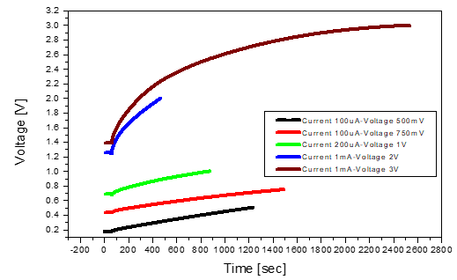
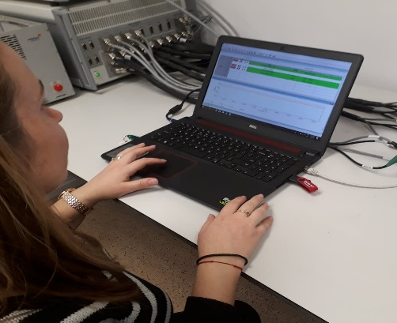
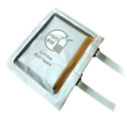
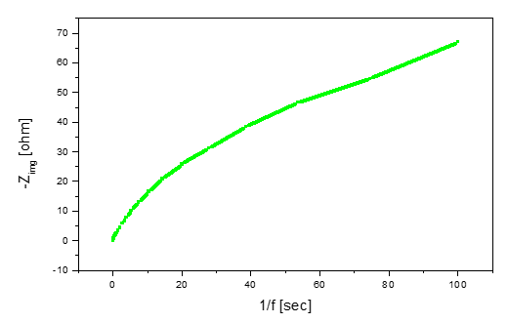
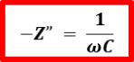
Our projects
Realization of Pouch cell Supercapacitor
3 V
Charging the supercapacitor to different voltage values up to 3V
The supercapacitor, Pouch type cell
Solartron Analytical system used to test the Pouch cell
C = 95.76 mF
Graph of the impedance negative imaginary part as a function of the inverse of the frequency

Slide 5
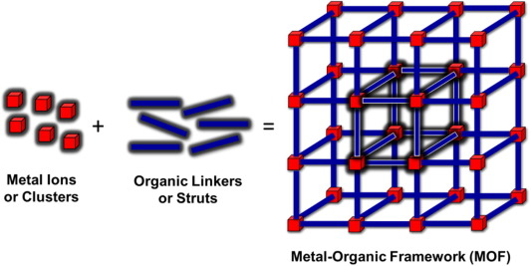
Our projects Realization a supercapacitor based on MOF
What is MOF?
Advantage: large active surface of the load storage
Disadvantage: low electrical conductivity

Slide 6
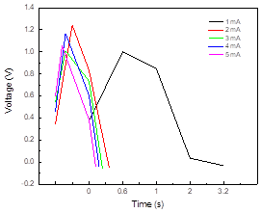
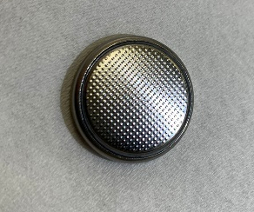
Our projects Realization a supercapacitor based on MOF
Supercapacitor using aqueous electrolyte (Li2SO4)
Iron-based MOF in proportion of 70%, Conductive Carbon Black (C65) in proportion of 20%, and PVdF binder in proportion of (10%)
Coin cell CR 2032
Total loading = 4.502 mg
The values of ESR and total capacitance
Current - 1mA
ESR (Ω) | 167.7
C (mF) | 1.37
Charging - discharging behavior of the supercapacitor based on MOF with different current values

Slide 7
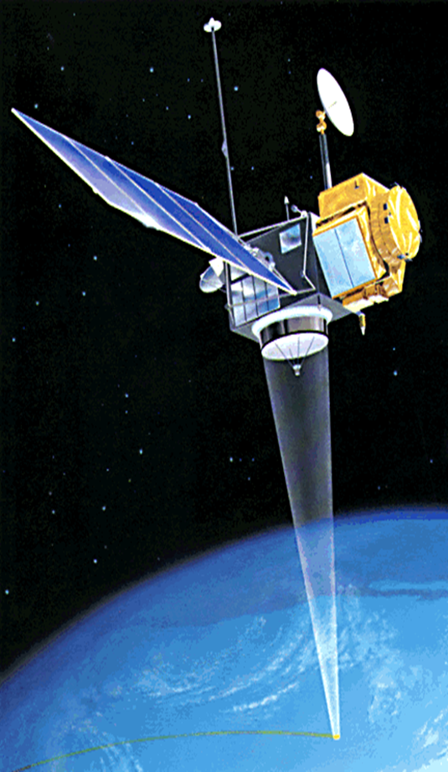
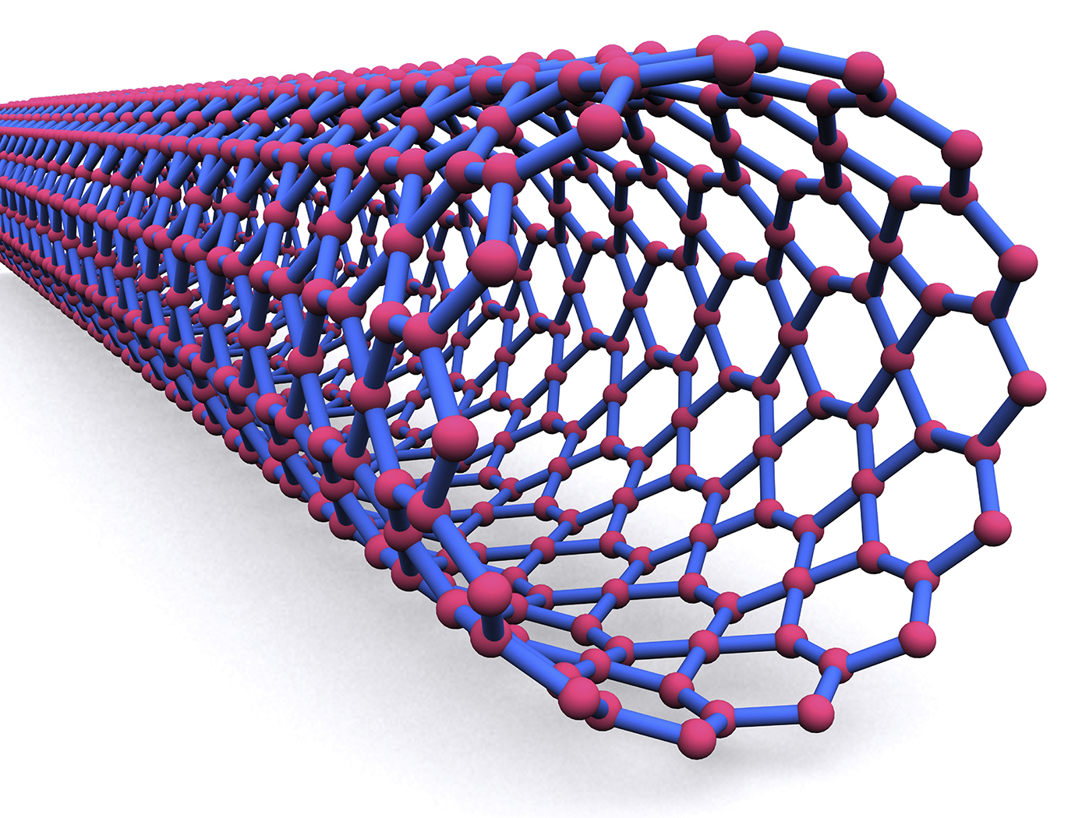
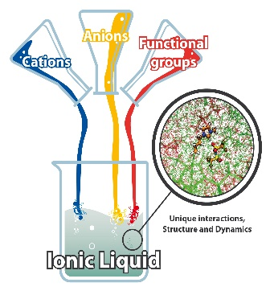
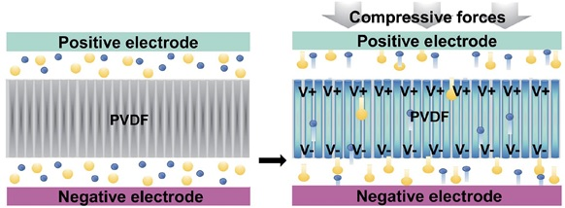
Our future projects
+
[2]
Carbon Nanotubes [1]
Carbon nanotubes and ionic liquid will be used to increase the rated voltage of supercapacitors.
[3]
Realization of a supercapacitor with piezoelectric effect.
Research on the use of supercapacitors in lighting systems used in space.
References
[1] https://www.chemistryworld.com/news/nanotubes-grow-to-record-lengths/6365.article
[2] https://www.chemie.uni-bonn.de/pctc/mulliken-center/kirchner/research_kirchner/ionic_liquids
[3] https://ro.wikipedia.org/wiki/Satelit_artificial

Slide 8
Thank you for attention!

